Slide 1
Word 题目

Slide 2
Word 题
Word ladder 求一个单词变到另一个单词最短距离(BFS)
Word ladder II 求一个单词变到另一个单词所有最短path(BFS + DFS)
Word Search 字符表格中能否查找一个单词(DFS)
WordSearch II 字符表格中查找所有字典单词(DFS + Trie/prefix hashset)
WordBreak 求一个单词能否由字典的词拼起来构成 (DFS)
WordBreak II 求一个单词由字典的词拼起来构成的所有解 (DFS + memo)
Word Concatenation 求字典中所有能由字典至少两个词拼起来的word(DFS+memo)
Word Square 求能拼成单词对称square的所有可能 （DFS+prefix hashmap）
Word Pattern 求一个单词是不是跟另一个单词数组有相同的pattern，(hashmap)
Word Pattern II 求一个单词是不是跟另一个单词有相同的pattern （DFS）
解题套路: DFS /BFS
1. 单词变化最短距离：BFS，关键点找neighbor
1. 单词表格搜索类： 搜索四个方向，按照每个字母确定搜索方向， DFS
2. 单词切割，组合类： 枚举切割点，DFS

Slide 3
Word ladder
Given two words (start and end), and a dictionary, find the shortest transformation sequence from start to end, output the length of the sequence. 求一个单词变到另一个单词最短距离(BFS)
Transformation rule such that:
Only one letter can be changed at a time, (帮助找边)
Each intermediate word must exist in the dictionary. (Start and end words do not need to appear in the dictionary )
Input：start ="hit"，end = "cog"，dict =["hot","dot","dog","lot","log"]
Output：5
Explanation： "hit"->"hot"->"dot"->"dog"->"cog”

Slide 4
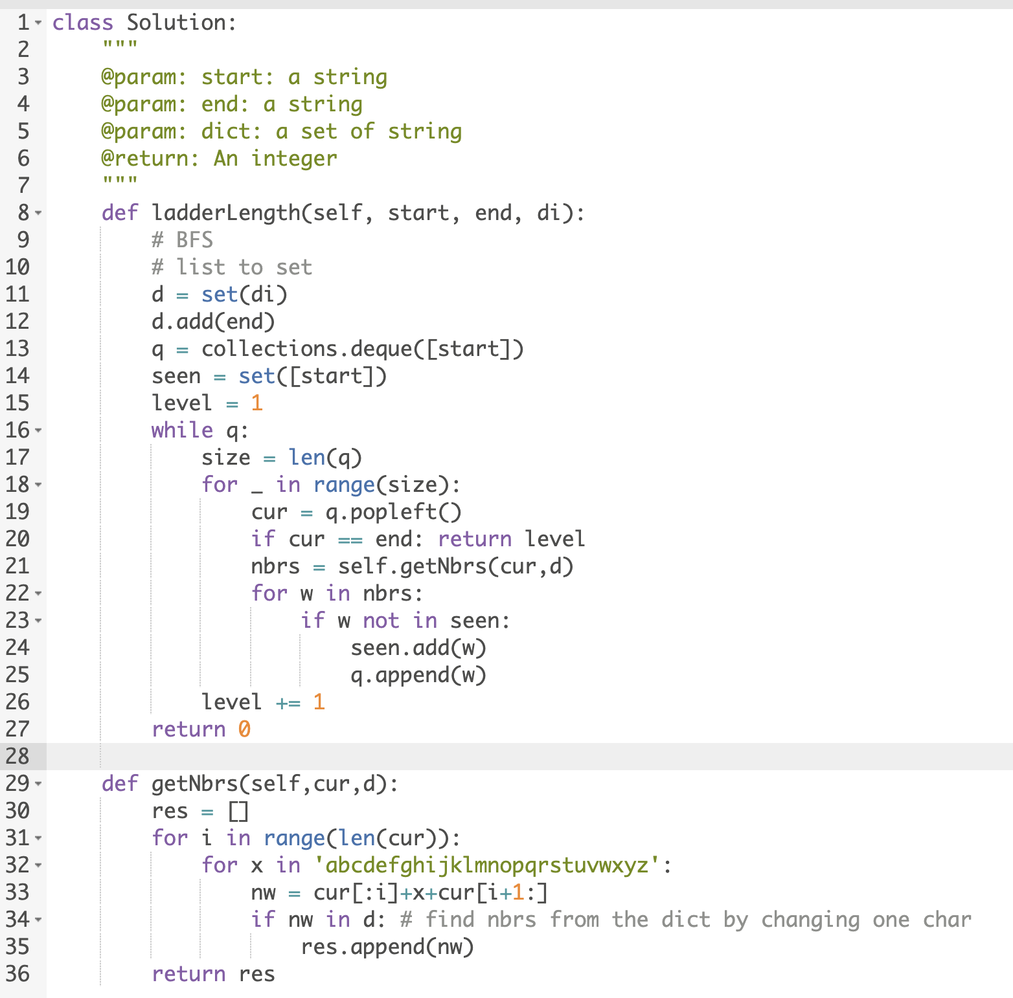
隐式图求最短距离 (BFS)
ait
dog
bit
hit
dot
….
cog
hot
lot
hpt
log
本质：隐式图求最短距离，节点是每个单词，每一步相邻节点是每个单词变化1个字母对应的单词+ 并且单词在字典里）

Slide 5
Word ladder II
Given two words (start and end), and a dictionary, find the shortest transformation sequences from start to end, output all sequences in dictionary order求一个单词变到另一个单词所有最短path(BFS + DFS)
Input：start ="hit"，end = "cog"，dict =["hot","dot","dog","lot","log"]
Output：[["hit","hot","dot","dog","cog"],["hit","hot","lot","log","cog"]]
Explanation：
1."hit"->"hot"->"dot"->"dog"->"cog”
2."hit"->"hot"->"lot"->"log"->"cog"
The dictionary order of the first sequence is less than that of the second.

Slide 6
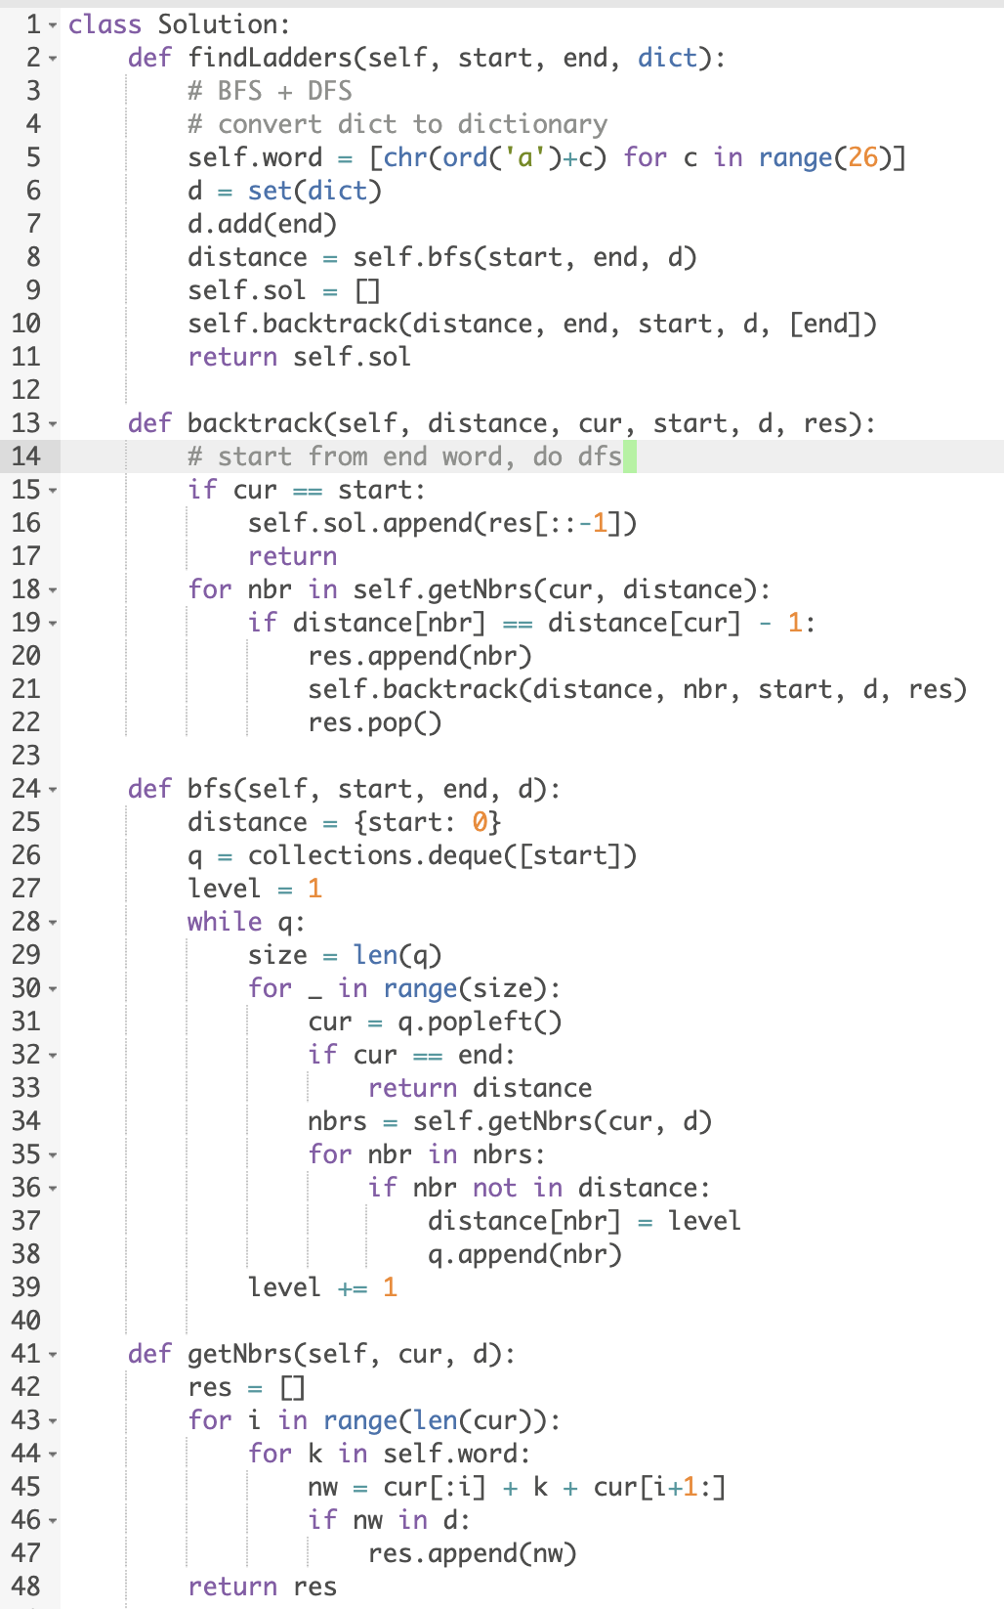
隐式图求所有最短距离 (BFS+DFS)
ait
dist[dog] =3
dog
bit
dist[dot] =2
hit
dot
….
dist[cog] =4
cog
hot
dist[dot] =2
dist[hot] =1
lot
dist[log] =3
hpt
log
本质：隐式图先BFS找到最短距离，根据距离反方向backtracking

Slide 7
Word Search
Given a 2D board and a word, find if the word exists in the grid. (True/False)
The word can be constructed from letters of sequentially adjacent cell, where "adjacent" cells are those horizontally or vertically neighboring. The same letter cell may not be used more than once.
字符表格中能否查找一个单词(DFS)
Input：["ABCE","SFCS","ADEE"]，"ABCCED"
Output：true
Explanation： [ A B C E
S F C S
A D E E ]
(0,0)A->(0,1)B->(0,2)C->(1,2)C->(2,2)E->(2,1)D

Slide 8
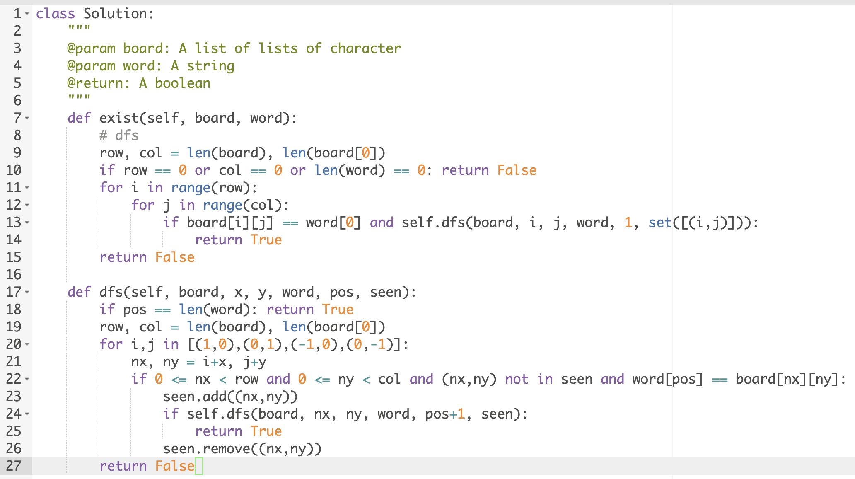
网格上的字符串搜索问题
DFS，走一步搜索上下左右四个方向，如果字符匹配，就继续搜索，找到一个结果（True）就直接返回
[ A B C E
S F C S
A D E E ]
要找"ABCCED"
(0,0)
(x,y)
(1,0)
(0,1)
(1,1)
(0,2)
(1,2)

Slide 9
Word Search II
Given a matrix of lower alphabets and a dictionary. Find all words in the dictionary that can be found in the matrix. A word can start from any position in the matrix and go left/right/up/down to the adjacent position. One character only be used once in one word. No same word in dictionary字符表格中查找所有字典单词(DFS + Trie/prefix hashset)
Input：d o a f
a g a i
d c a n
Dictionary ["dog","dad","dgdg","can","again"]
Output：["again","can","dad","dog"]

Slide 10
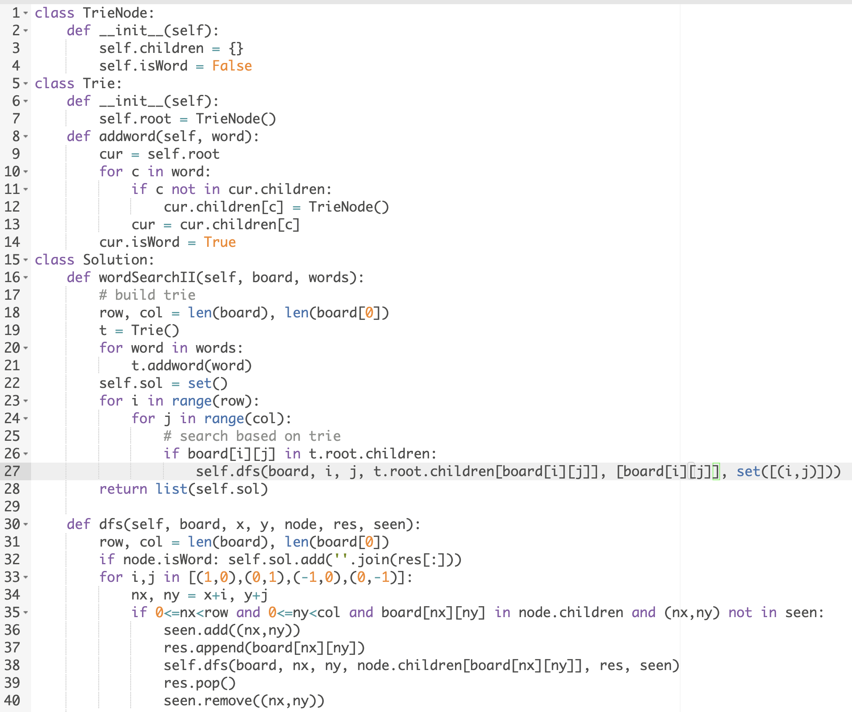
根据字母搜索四个方向，按照每个字母确定搜索方向，利用Trie保存字典
DFS，走一步搜索上下左右四个方向，如果在trie里，就继续搜索，如果isword is True，记入结果
Input：d o a f
a g a i
d c a n
Dictionary ["dog","dad","dgdg","can","again"]
Root.children
root
d, c, a
False
o, a, g
a
g
False
False
False
g
d
d
False
False
False
…
g
True
True
False
True

Slide 11
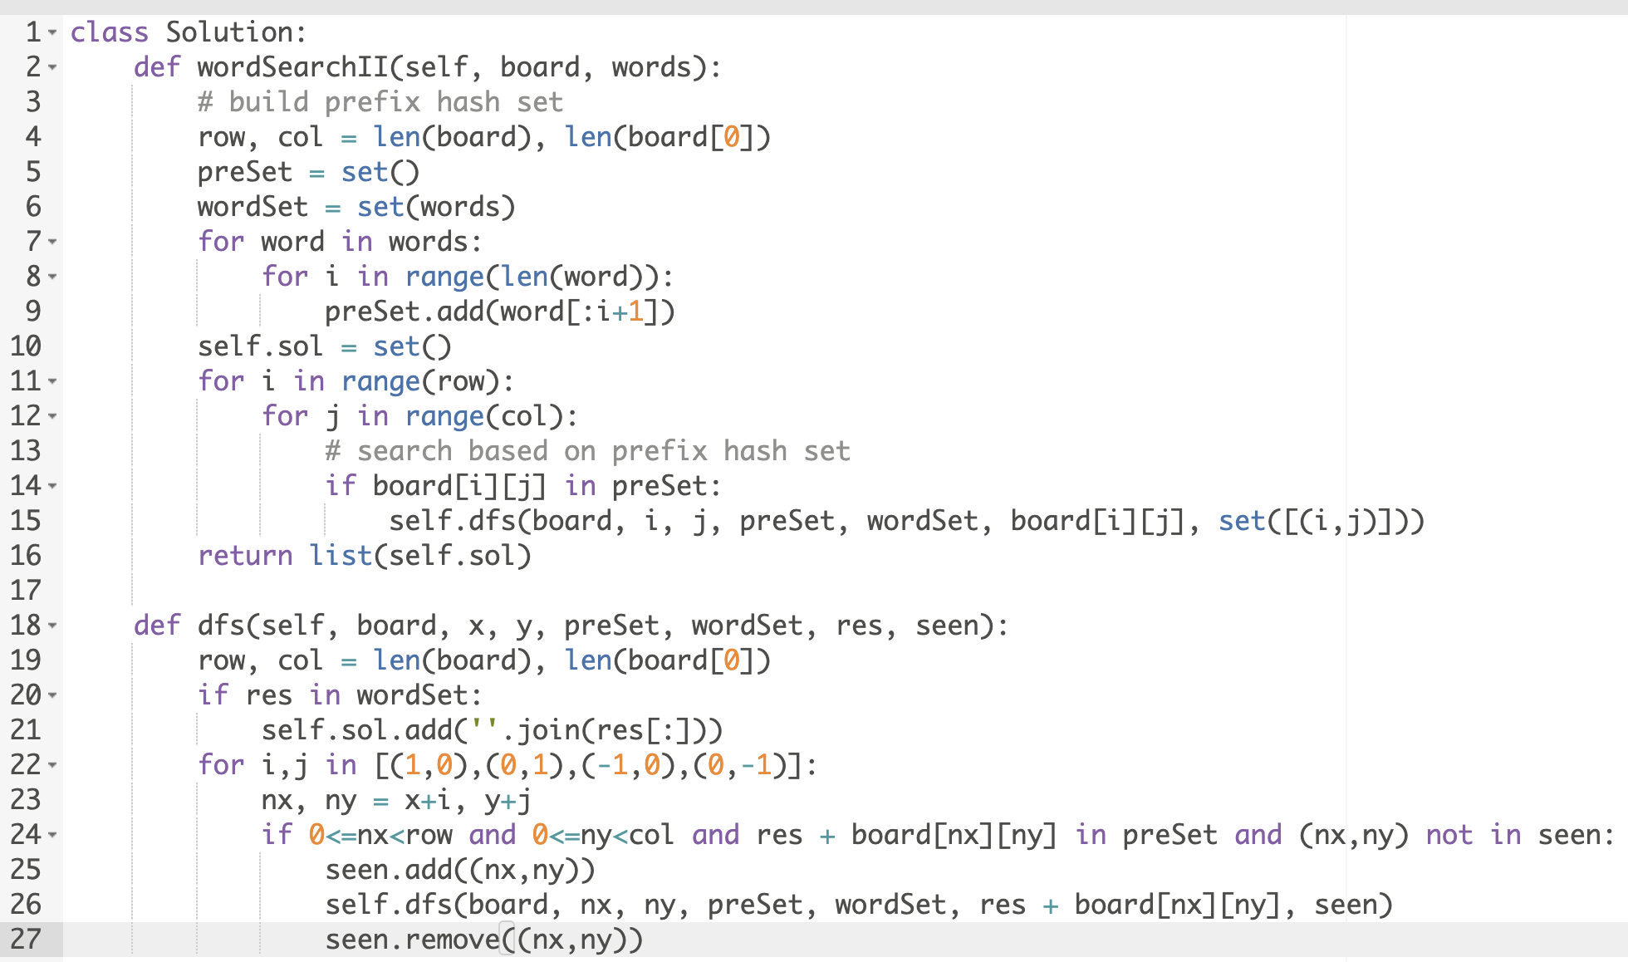
利用prefix hash set保存字典
Input：d o a f
a g a i
d c a n
Dictionary ["dog","dad","dgdg","can","again"]
preSet = {‘d’, ’do’, ’dog’, ’da’, ’dad’, ’dg’, ’dgd’, ’dgdg’, ’c’, ’ca’, ’can’, ’a’, ’ag’, ’aga’, ’agai’, ’again’}

Slide 12
Word Break
Given a string s and a dictionary of words dict, determine if s can be broken into a space-separated sequence of one or more dictionary words.求一个单词能否由字典的词拼起来构成 (DFS)
Input: “lintcode”, [“lint”, “code”, ‘aaa’]
Output: true
Input: "a", ["a"]
Output: true
解题思路：走一步，枚举所有可能切割点，DFS

Slide 13
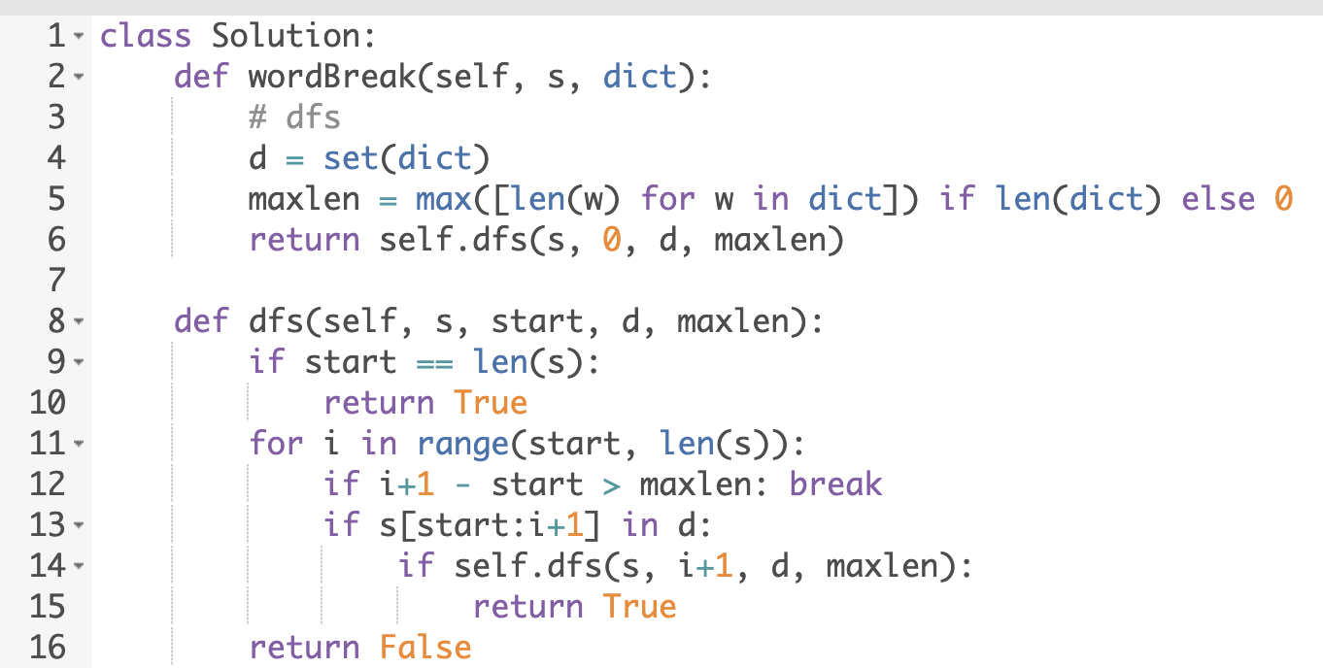
DFS
走一步，尝试找到所有可能切割位置（candidate），如果左边部分是一个单词，继续搜索剩下的字符串
Lint｜code
0
1
lint
lintc
l
li
lin
0
1
2
3
4
maxlen
。。。
code
7
Maxlen * maxlen
“lintcode”, [“lint”, “code”, ‘aaa’]
maxlen * maxlen *maxlen

Slide 14
Word break II
Given a string s and a dictionary of words dict, add spaces in s to construct a sentence where each word is a valid dictionary word.
求一个单词由字典的词拼起来构成的所有解 (DFS + memo)
Return all such possible sentences.
Input："lintcode"，["de","ding","co","code","lint"]
Output：["lint code", "lint co de"]
解题思路：走一步，枚举所有可能切割点，DFS

Slide 15
DFS
走一步，尝试找到所有可能切割位置（candidate），如果左边部分是一个单词，继续搜索剩下的字符串
S = “lintcode”,
Word dict = [“lint”, “code”, ‘aaa’, ‘co’, ‘de’]
0
枚举切割位置
Lintcode
lint
lintc
l
li
lin
0
1
2
3
4
。。。
code
走一步
子问题的解
co
code
“lint” + [[“code”], ["co”, “de"]]
= [’lint’, ‘code’]
[‘lint’, ‘co’, ‘de’]
5
7
de
7

Slide 16
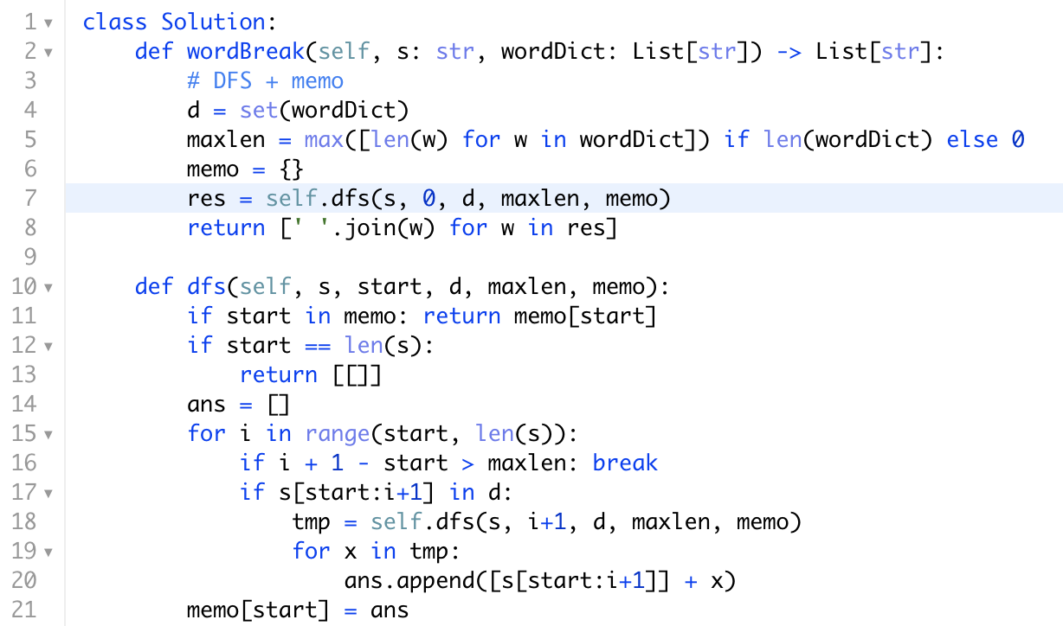
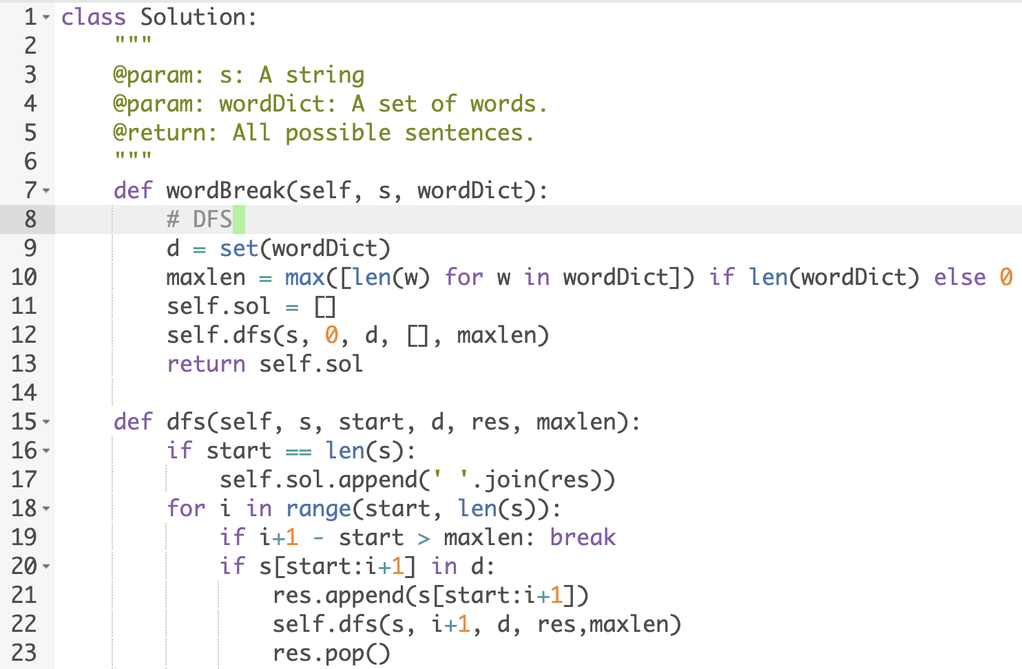
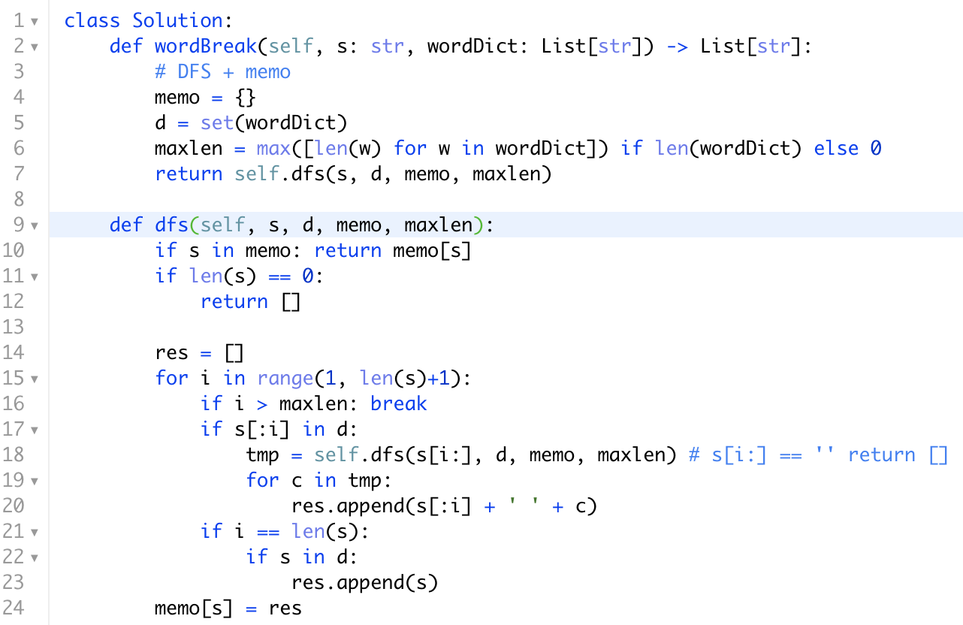
DFS
"lintcode"，["de","ding","co","code","lint"]
DFS + memo
Use index as key of memo
Return ans
暴力DFS （超时）
为什么超时？A: 重复计算
S = ‘aaaaaaaaaaaaaaaaa’
Wordict = [‘a’, ’aa’, ’aaa’]
Return ans
Use word as key of memo

Slide 17
Word concatenation
Given a list of words (without duplicates), please write a program that returns all concatenated words in the given list of words. A concatenated word is defined as a string that is comprised entirely of at least two shorter words in the given array.
求字典中所有能由字典至少两个词拼起来的word(DFS+memo)
Input: [“cat”,“cats”,“catsdogcats","dog","dogcatsdog","hippopotamuses","rat","ratcatdogcat"]
Output: ["catsdogcats","dogcatsdog","ratcatdogcat"]
Explanation: "catsdogcats" can be concatenated by "cats", "dog" and "cats"; "dogcatsdog" can be concatenated by "dog", "cats" and "dog"; "ratcatdogcat" can be concatenated by "rat", "cat", "dog" and "cat".
解题思路：走一步，枚举所有可能切割点，DFS

Slide 18
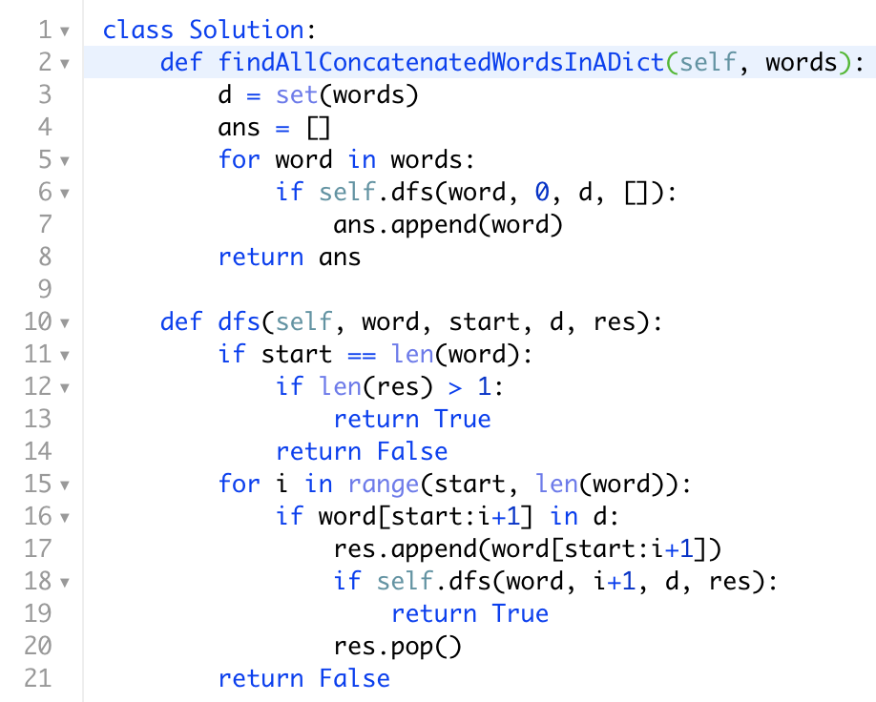
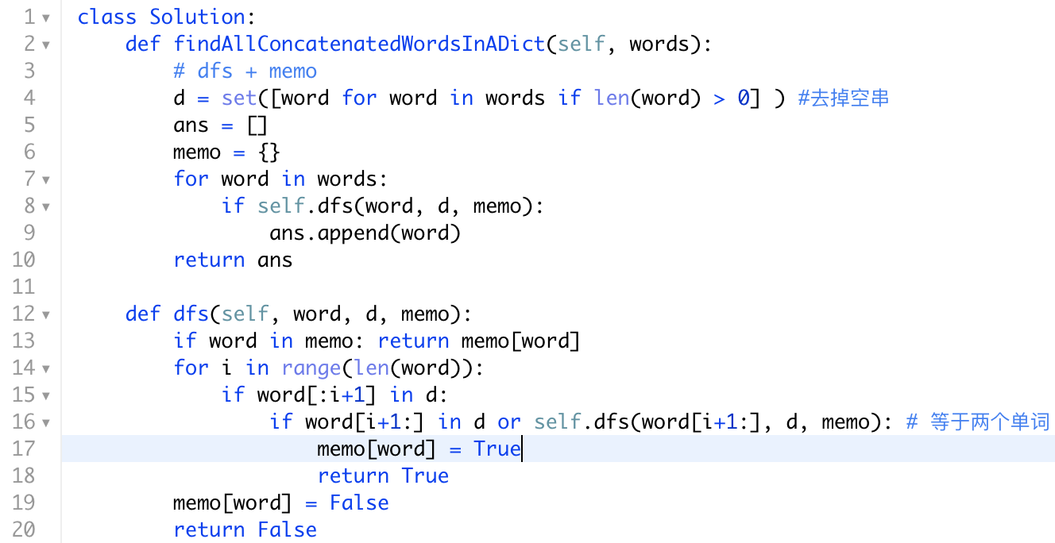
DFS and DFS+ memo
Cats: False
Catsdogcats: True
Cats|dog : False
["cat","cats", “dog|cats “,"cats|dog |cats”, "dog”,]
L
n
1, 2, 3 +… n
DFS
DFS + memo

Slide 19
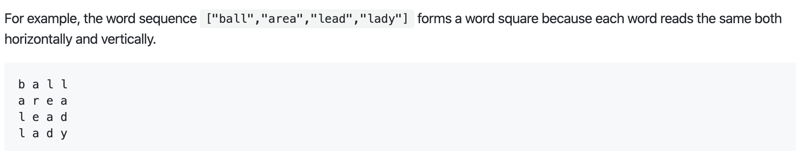
Word square
Given a set of words without duplicates, find all word squares you can build from them.
A sequence of words forms a valid word square if the kth row and column read the exact same string, where 0 ≤ k < max(numRows, numColumns).

Slide 20
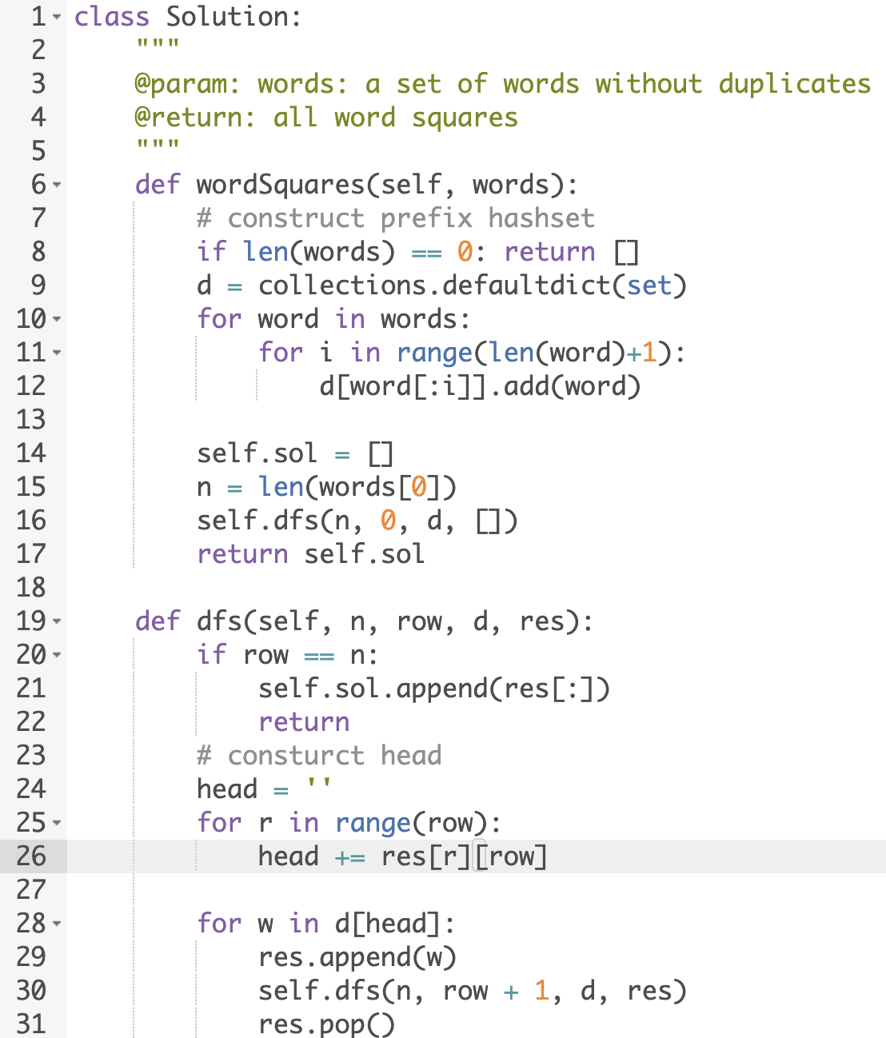
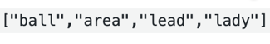
DFS + Prefix hashset
逐行填写单词，最暴力方法直接permutation，挑一个没选过的单词
剪枝方法：每一行的单词的前缀需要满足对称性,利用prefix hashset
“”: ball, area, lead, lady
‘b’: ball
’ba’: ball
‘bal’: ball
‘ball’:ball
’a’: area
‘L’:lead, lady
‘le’:lead
b a l l
a r e a
l e a d
l a d y
ball
area
lead
lady
area
lead
D[ball]. Hash= B * 31^3 + a*31^2 + l*31 + l
lady

Slide 21
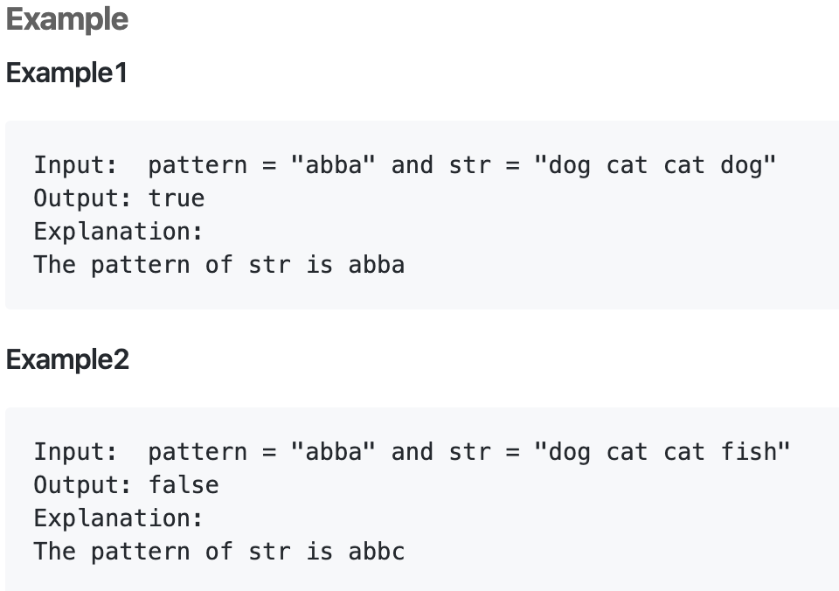
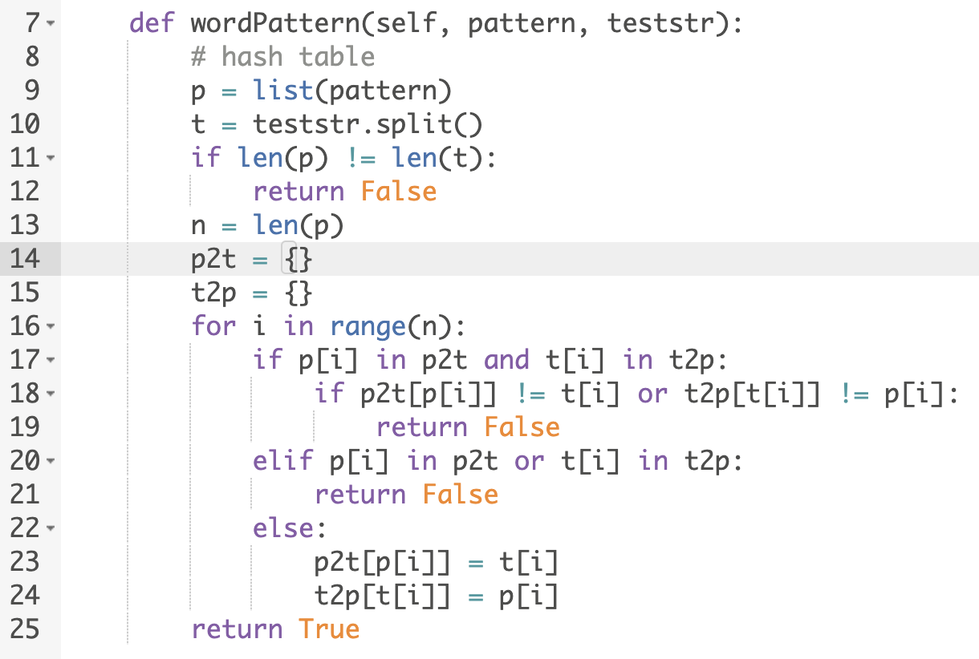
Word pattern (hash map)
Given a pattern and a string str, find if str follows the same pattern. Here follow means a full match, such that there is a bijection between a letter in pattern and a non-empty word in str.
建立双向hashmap，

Slide 22
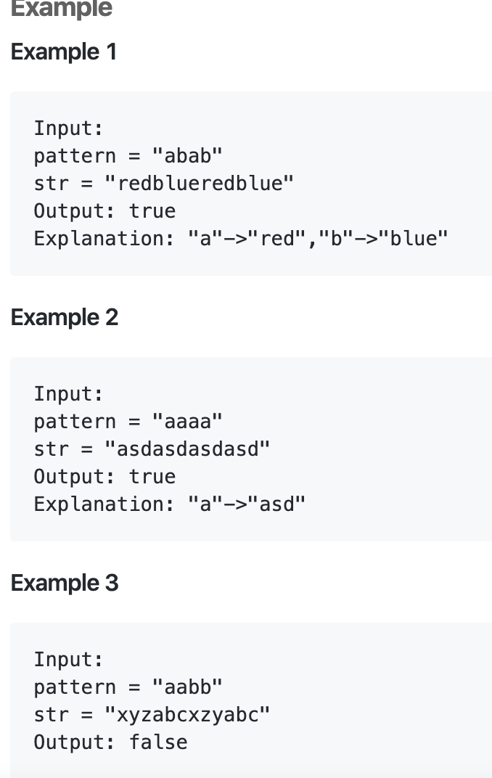
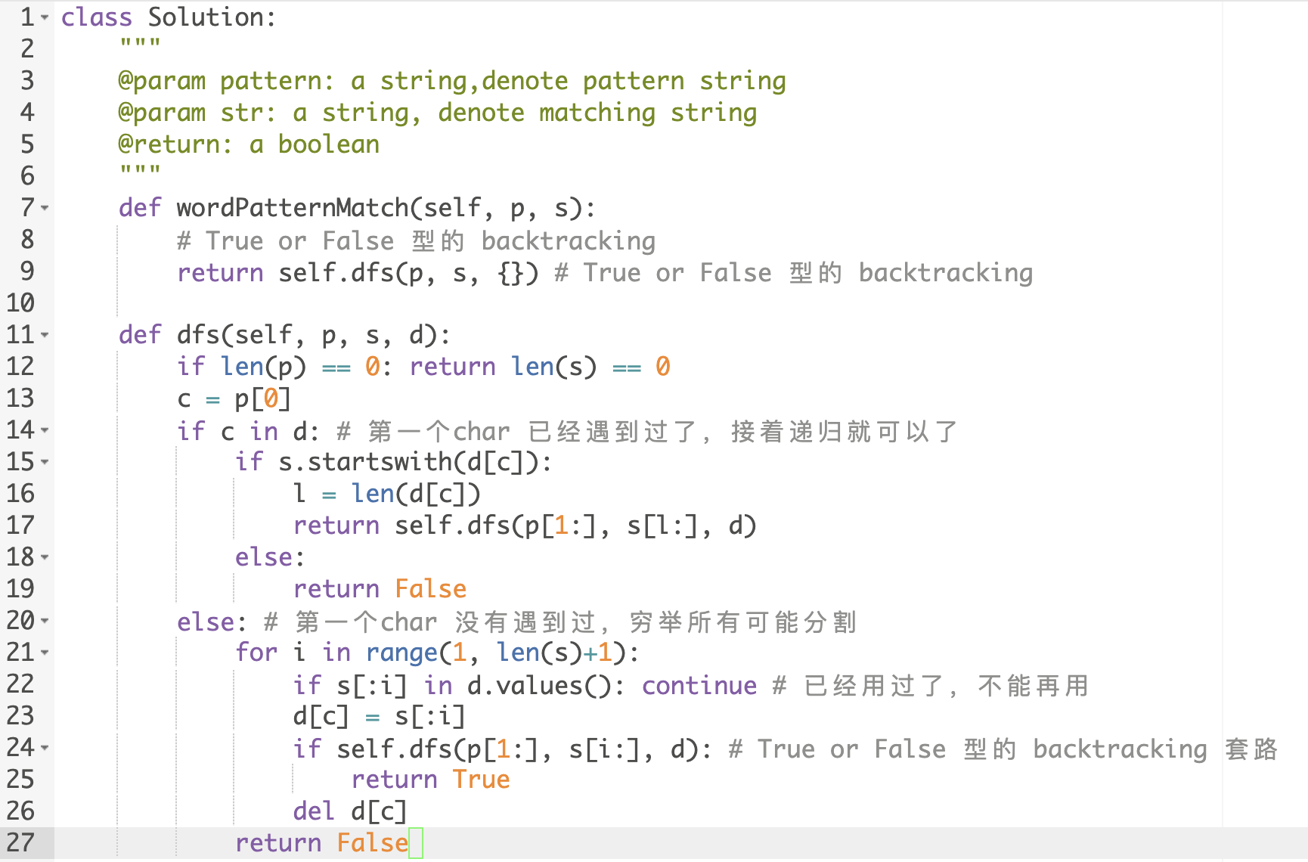
Word Pattern II (DFS)
Given a pattern and a string str, find if str follows the same pattern.
解题思路：走一步，枚举所有可能切割点，DFS

Slide 23
总结
求单词变化最短距离问题： BFS， 关键是找neighbor
字母搜索问题，每次拿一个字符出来，搜索上下左右四个方向
切割字符串，走一步，枚举所有可能切割字符串的位置，找的valid的切割，进行下一步DFS搜索
加Memo，以单词或者string作为key，也可以用切割位置index作为key
Trie 和 prefix hashset/hashmap 可以用来处理需要查询许多单词或者单词有overlap很多的情况

Slide 24
相关题目
网格搜索最长连续上升序列 （DFS）
套路：每一步考虑搜索上下左右四个方向
字符串palindrome partition，palindrome pairs
套路：分割字符串，枚举所有的分割位置

Slide 25
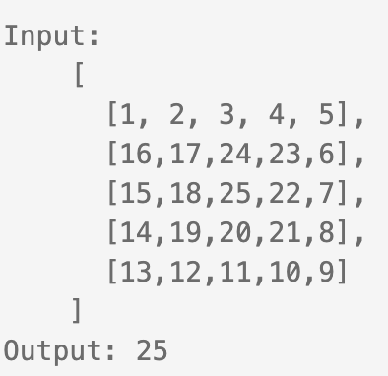
Longest continuous increasing subsequence （滑雪题，网格搜索）
Given an integer matrix. Find the longest increasing continuous subsequence in this matrix and return the length of it.
The longest increasing continuous subsequence here can start at any position and go up/down/left/right.
Example 1:
Explanation: 1 -> 2 -> 3 -> 4 -> 5 -> ... -> 25 (Spiral from outside to inside.)
网格搜索类

Slide 26
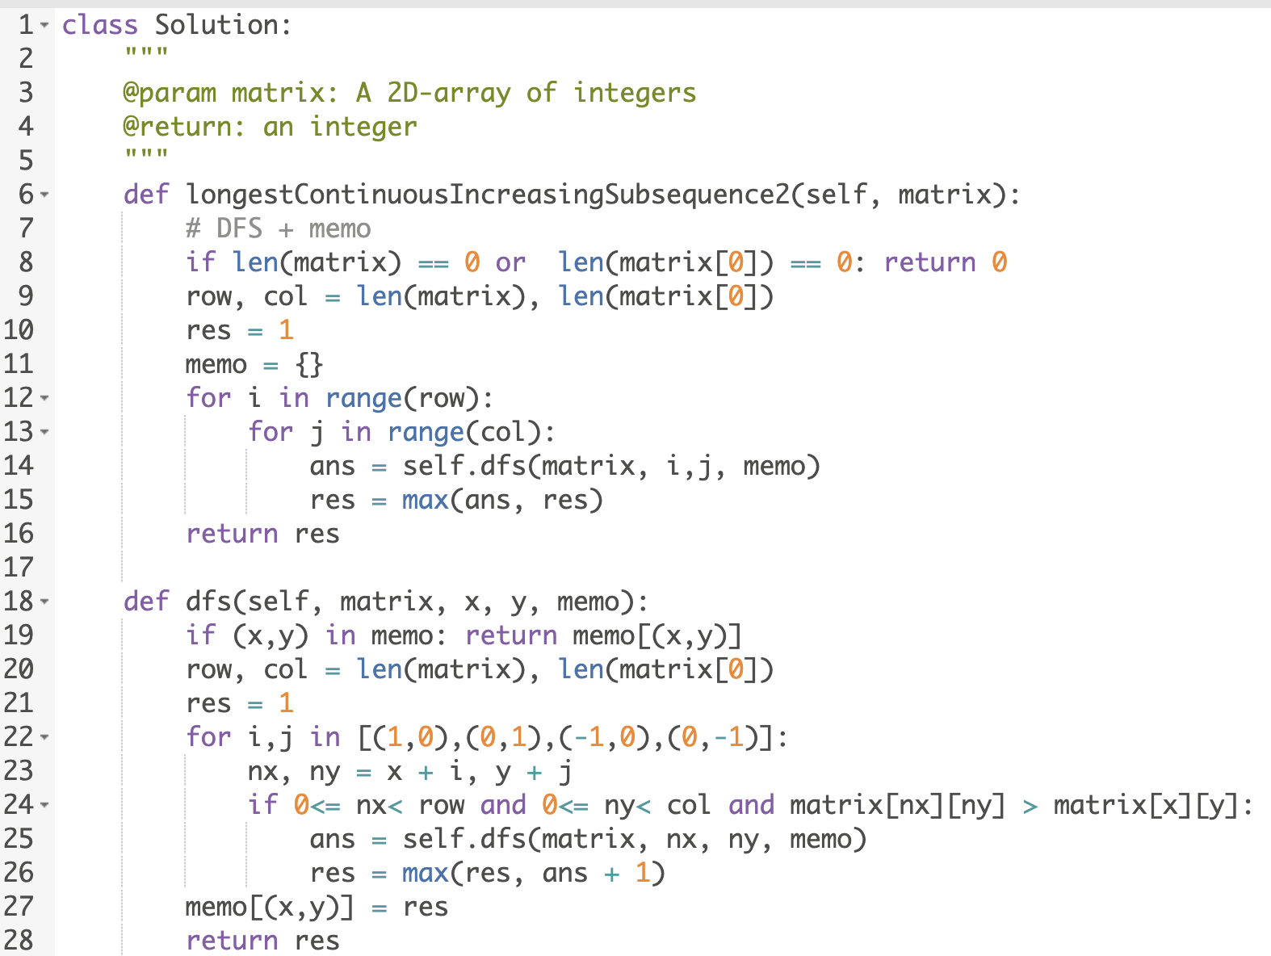
网格搜索最长连续序列
DFS，每一步搜索上下左右四个方向
dfs(x,y) = max(dfs(x+1,y) +1 | board[x+1][y] > board[x][y],
dfs(x-1,y) +1 | board[x-1][y] > board[x-1][y],
dfs(x,y+1)+1 | board[x][y+1] > board[x][y+1],
dfs(x,y-1) +1 | board[x][y-1] > board[x][y-1])

Slide 27
Palindrome Partition (word)
Given a string s, partition s such that every substring of the partition is a palindrome.
Return all possible palindrome partitioning of s.
Example:
Input: "aab"
Output: [ ["aa","b"], ["a","a","b"] ]
解题方法，跟word break 套路一样, 切割字符串，走一步，枚举所有可能切割字符串的位置，找的valid的切割，进行下一步DFS搜索

Slide 28
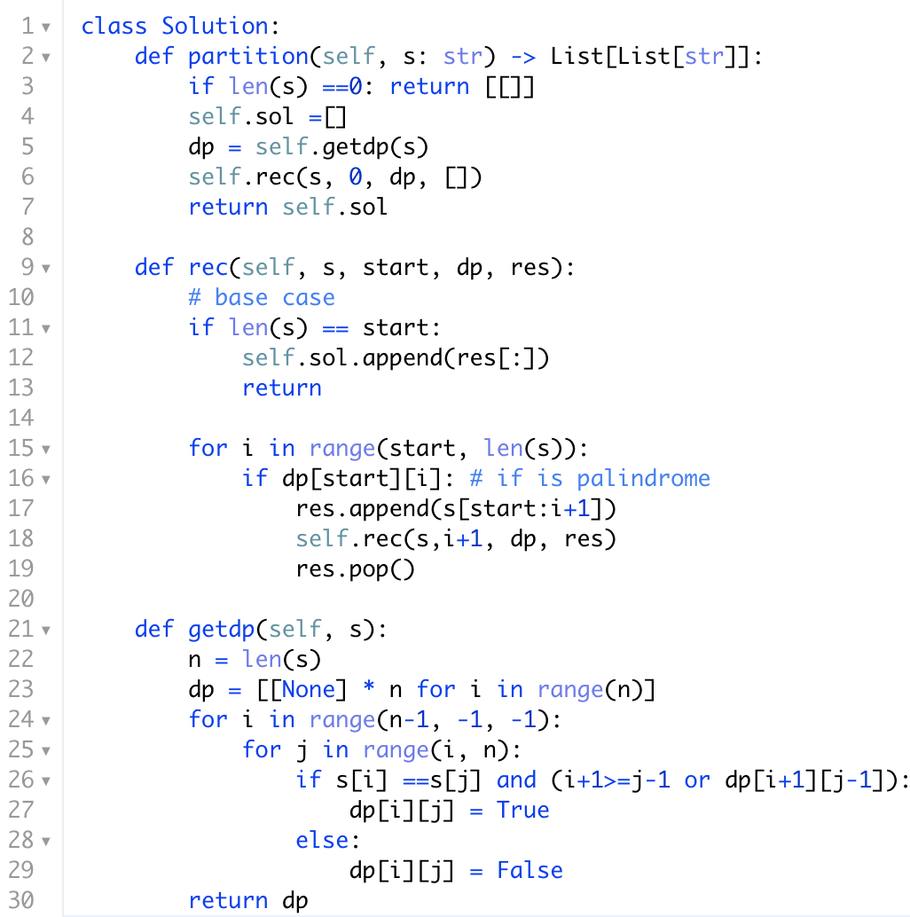
走一步，枚举所有可能的分割点
aab
aab|
a|ab
aa|b
a|b
b |
b |
可行解
搜索树
可行解

Slide 29
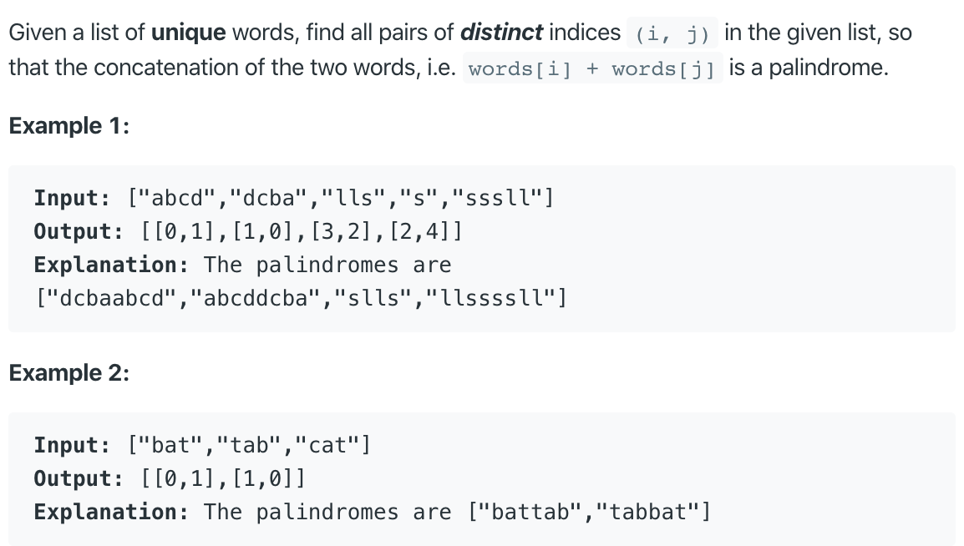
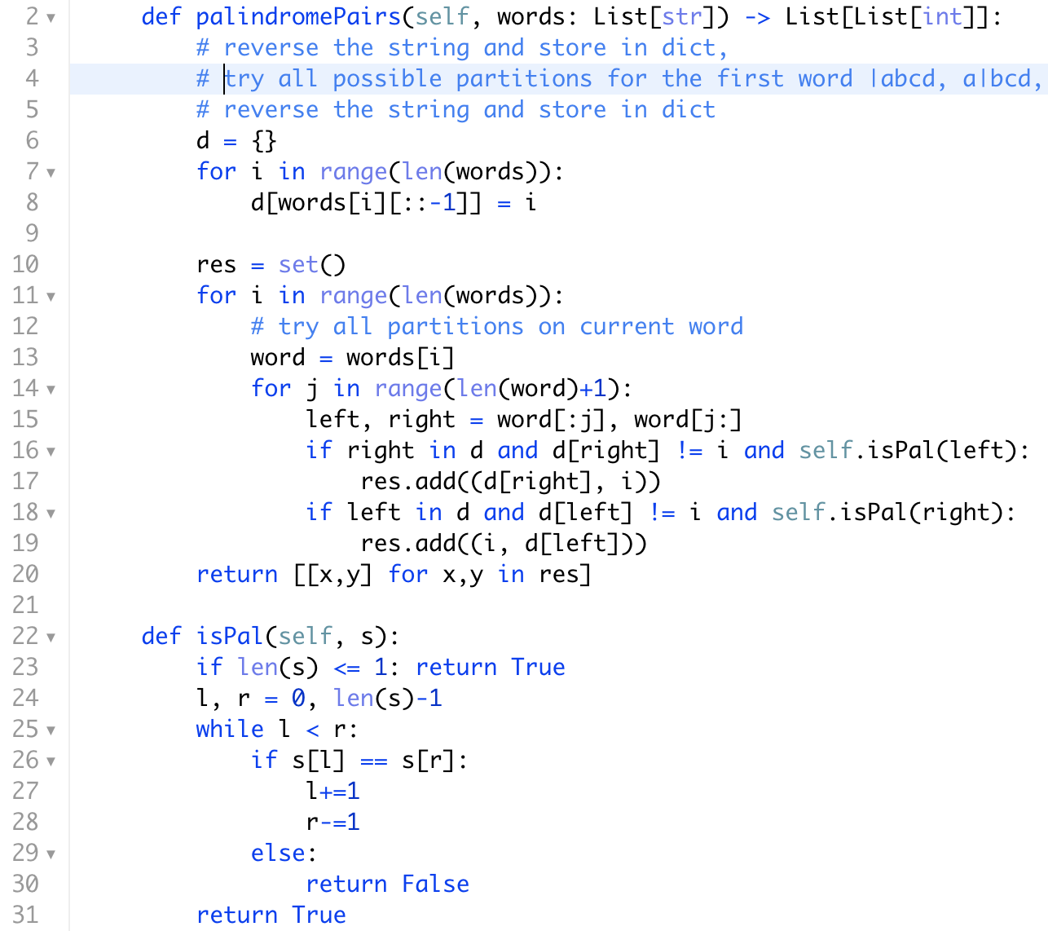
336. Palindrome Pairs (hashmap)
套路: 枚举切割点位置
Leftpart | rightpart,
Case1: Reversedword| Leftpart | rightpart,
Case2: Leftpart | rightpart | Reversedword
|lls
1. ‘’ is pal and Search for sll
2. sll is not pal
l | ls
1. ‘l’ is pal and Search for sl
2. sl is not pal
ll | s
1. ‘ll’ is pal and Search for s
2. s is pal and search for ll
lls |
‘lls’ is not pal
‘’ is pal and search for sll

Slide 30
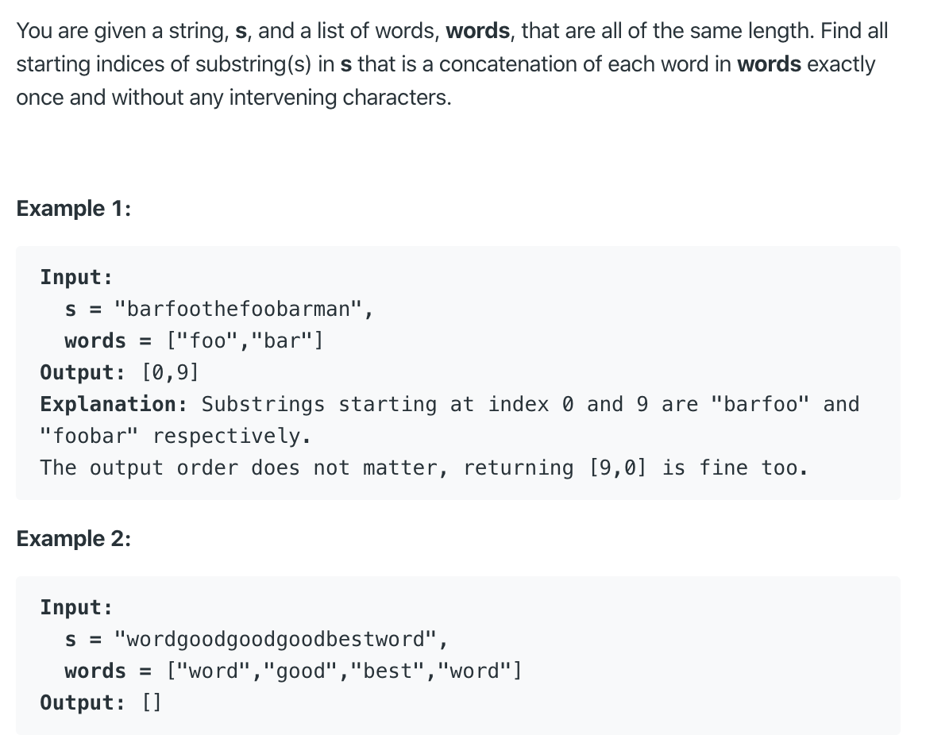
30. Substring with Concatenation of All Words
解题思路，sliding window

Slide 31
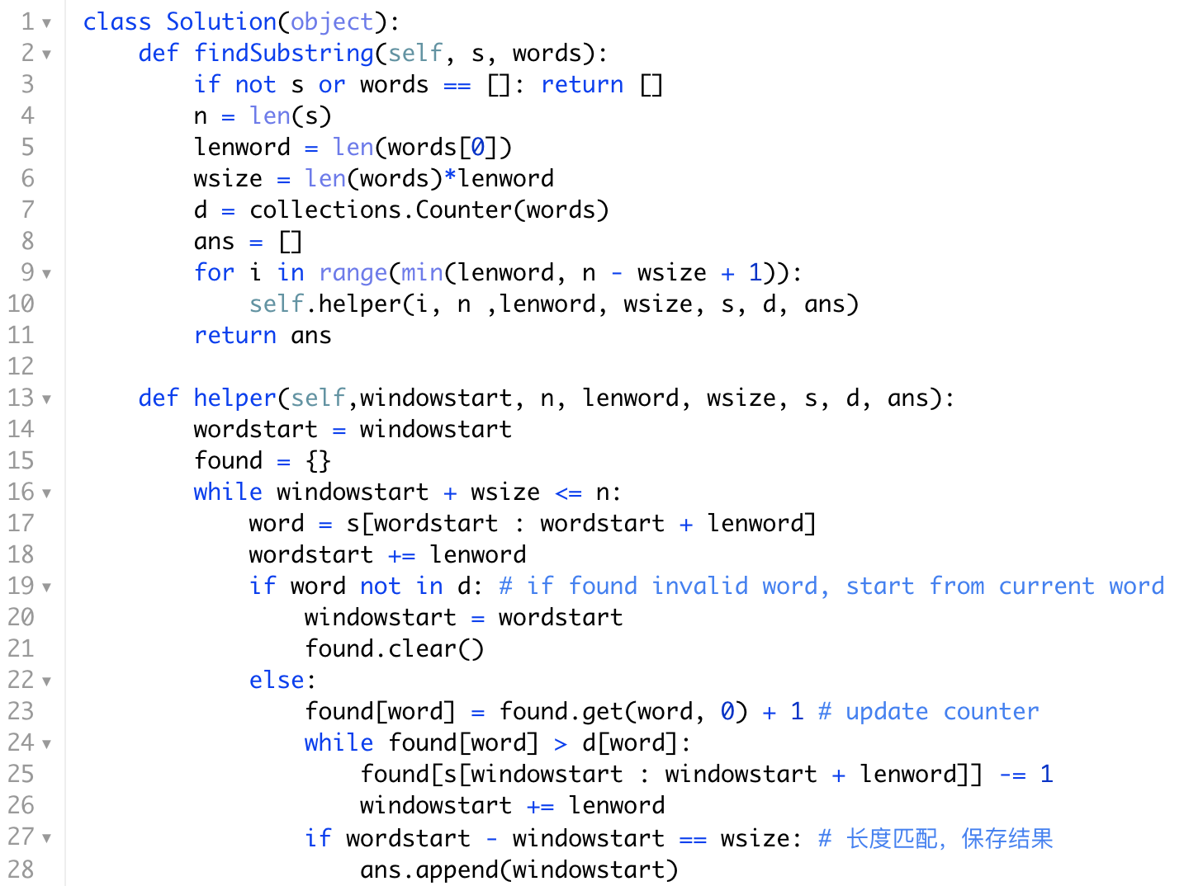
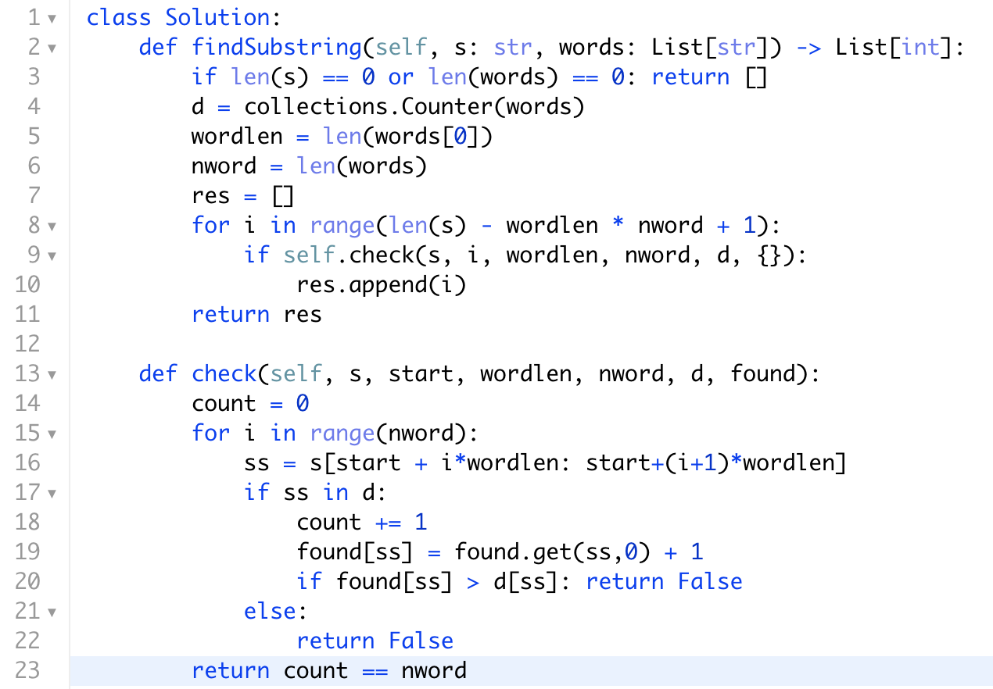
Hash map or hashmap + 双指针
两层for循环，遍历每一个开始位置
双指针

